Slide 1
Prometheus in Practice
Weaveworks – https://weave.works – @weaveworks

Slide 2

Unless specified, these slides are © Weaveworks 2019.
They are made available under a Creative Common License.
Attribution-NonCommercial-ShareAlike 4.0 International (CC BY-NC-SA 4.0)
You can attribute in the following way:
“Created by Weaveworks / Derived from material created by Weaveworks.
Original available at https://tinyurl.com/hands-on-prometheus”

Slide 3
Prerequisites
A Kubernetes Cluster
To which you have kubectl access
On which the Weave Cloud agents are installed
On which are deployed the standard demo manifests

Slide 4
Prometheus in practice

Slide 5
Querying metrics with Prometheus

Slide 6
GitOps hands-on 1/10
💻
Check what was installed
Look at what’s running on the cluster with
➤ kubectl get pods --all-namespaces

Slide 7
💻
Inspect the raw metrics directly
From your console, run: ➤ kubectl run busybox -it --rm --restart=Never --image=yauritux/busybox-curl -- curl http://podinfo.dev:9898/metrics
And try to find these metrics that show:
The number of open file descriptors
The number of HTTP requests received

Slide 8
💻
Inspect the raw metrics directly
# HELP process_open_fds Number of open file descriptors. # TYPE process_open_fds gauge process_open_fds 7
# HELP http_requests_total The total number of HTTP requests. # TYPE http_requests_total counter http_requests_total{status="200"} 136

Slide 9
Understanding metrics
Each line on that page is either a comment or a time series
A time series has a name, optional labels, and a series of values
A collection of time series with the same name is a metric

Slide 10
Understanding metrics
For example:
http_requests_total{status="200"} 136
name is http_requests_total
one label, status, with label value "200"
value is 136
Since the pod launched, we've received 136 HTTP requests with status 200.

Slide 11
Checkpoint:
Metrics are visible

Slide 12
Exercise: query metrics
💻
Query the metrics (Table)
On your Weave Cloud instance:
Go to "Monitoring"
Create a notebook
Call it "Monitoring in Practice"
Enter http_requests_total and then click "Run as Table"

Slide 13
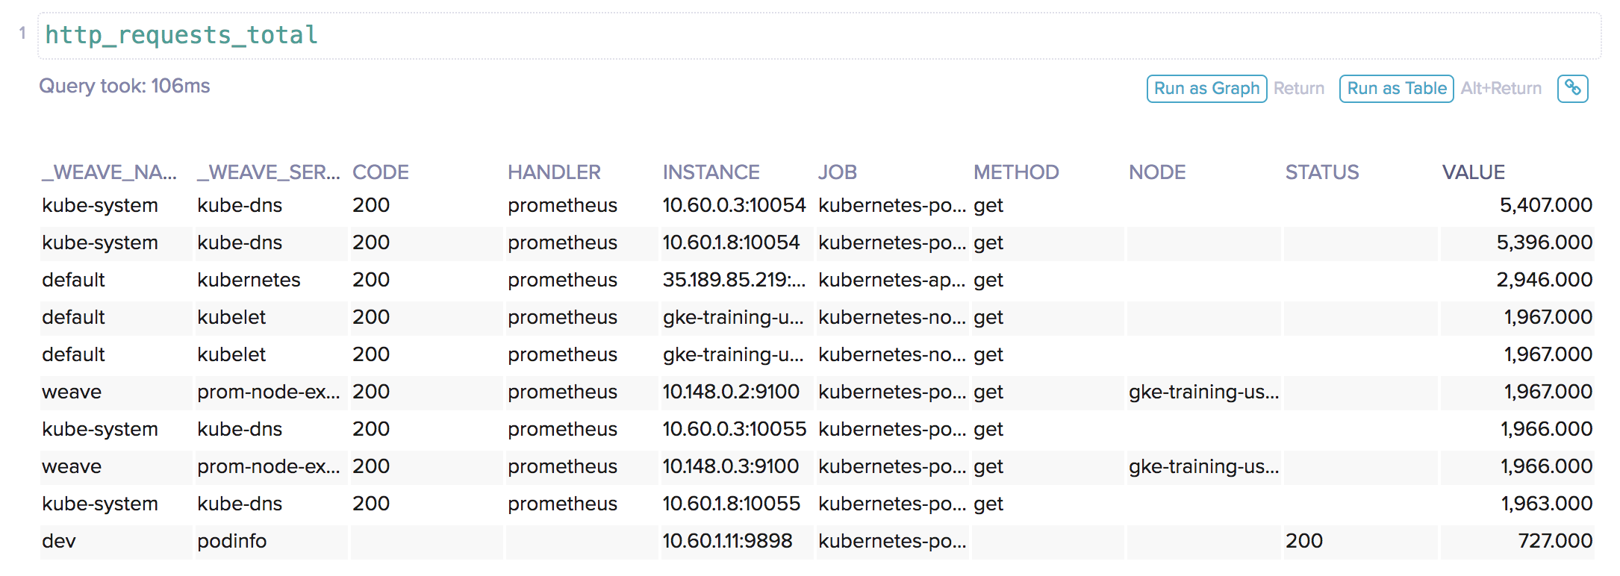
💻
Query the metrics (Table)

Slide 14
Where did those extra labels come from?

Slide 15
Some labels added automatically
Our pod has grown instance, job, kubernetes_namespace, and _weave_service labels.
These were added at the point of scraping so time series don't clash with each other and so you can find the source of your data.

Slide 16
Why do some lines say code and some status?

Slide 17
Label schema is flexible
Some pods use slightly different labels (e.g. code instead of status). This highlights that Prometheus doesn't impose a schema on labels—they are free-form.
Highly recommended that you form a consistent standard across your key applications.

Slide 18
Exercise: query metrics
💻
Query the metrics (Graph)
On your Weave Cloud instance:
Go to "Monitoring"
Create a notebook
Call it "Monitoring in Practice"
Enter http_requests_total and then click "Run as Graph"

Slide 19
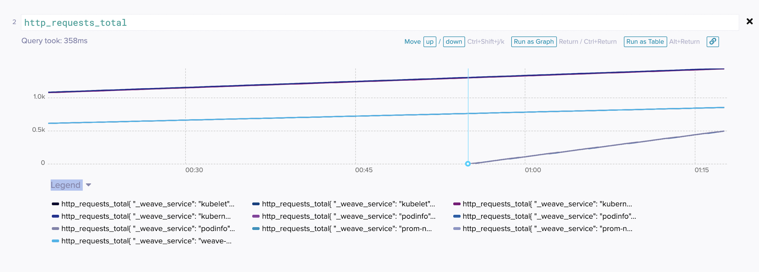
Checkpoint:
Generating graphs

Slide 20
Filtering metrics
💻
Query the metrics using labels
What if we only want to see the data from our service?
In a new cell, run the following query as a table:
http_requests_total{_weave_service="podinfo"}
This only shows the time series which have labels that exactly match those above. PromQL also support not equals (!=) and regular expression matching (=~ and !~).

Slide 21
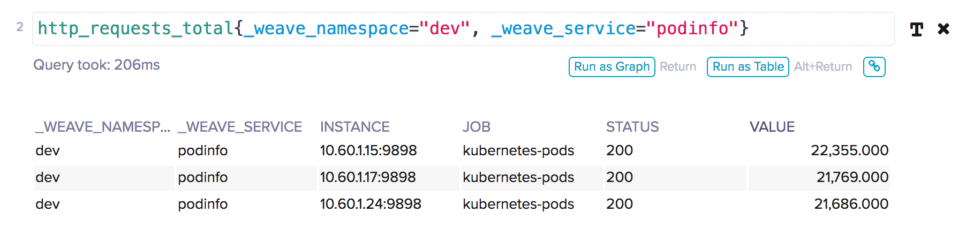
💻
Query the metrics using labels

Slide 22
Aggregating metrics
💻
Aggregate metrics using functions
What if we want to get the total requests for our whole cluster?
In a new cell, enter the following:
sum(http_requests_total)
This adds up all the requests to give us a single value.

Slide 23
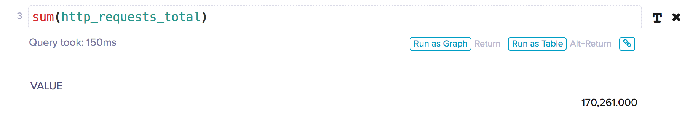
💻
Aggregate metrics using functions

Slide 24
Aggregating metrics
💻
Aggregate metrics by labels
If you look at our original query, you see there are separate lines for each replica. Multiple rows refer to kube-dns or kubelet. How do we aggregate those metrics together?
In a new cell, run the following query:
sum(http_requests_total) by (kubernetes_namespace)
Note only the labels in our by clause are preserved.

Slide 25
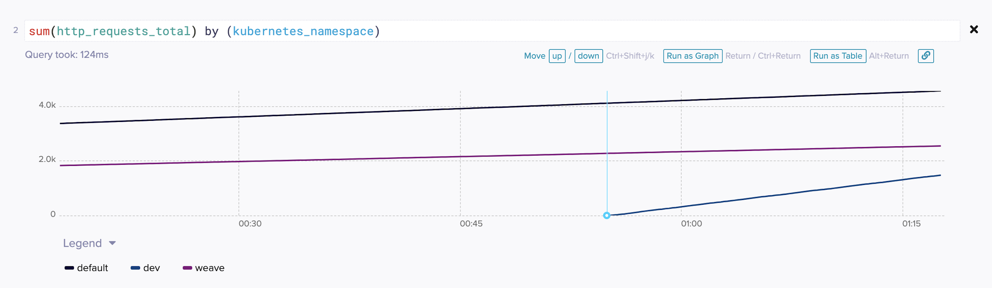
💻
Aggregate metrics by labels

Slide 26
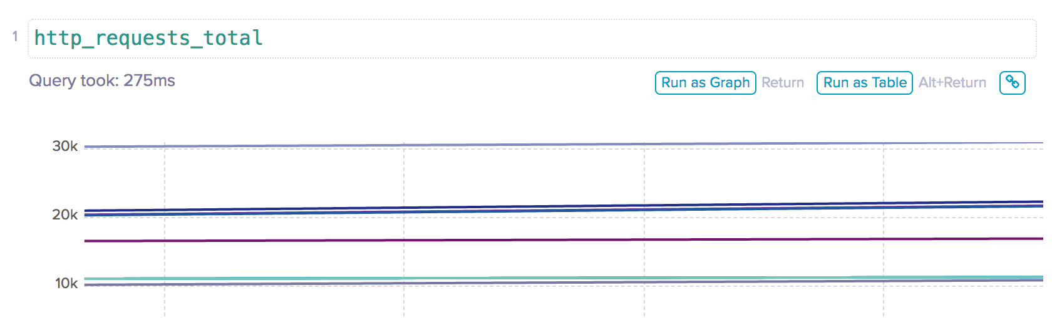
Differentiating metrics
Look at the graph view of our first query. What's the deal with these lines going up all the time?
http_requests_total is a counter. It goes up by one every time there's an HTTP request. It never goes down.
What if we wanted to see requests per second?

Slide 27
Differentiating metrics
💻
Derive a gauge from a counter
In a new cell, run:
rate(http_requests_total[1m])
and make sure to see the graph view. What do you see?
Try changing the time interval from 1m to other values (5m, 2h, 10s). What do you think is happening there?

Slide 28
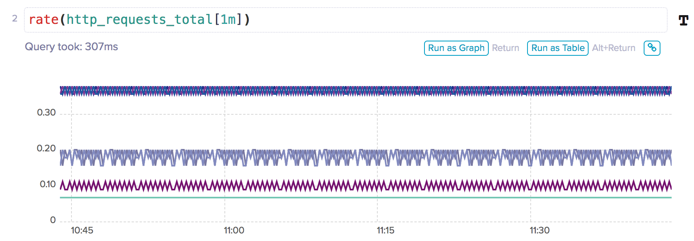
💻
Derive a gauge from a counter

Slide 29
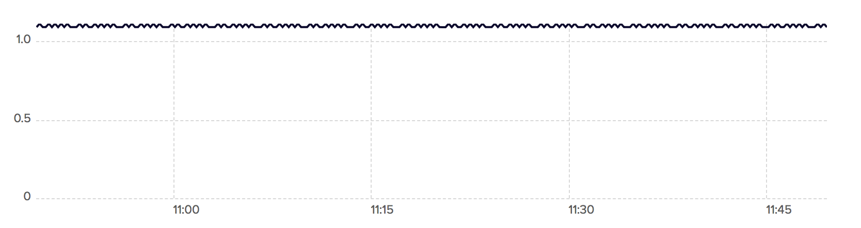
Putting it all together
💻
Create a custom query
We now know enough to get a graph of HTTP requests per second for dev/podinfo that will work regardless of how many replicas it has.
Create a query that results in a graph of HTTP request rate for dev/podinfo. It will look like the below.

Slide 30
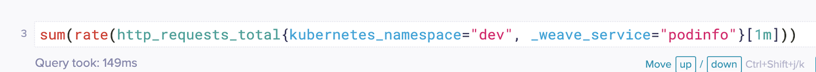
💻
Create a custom query

Slide 31
Generating more traffic
💻
Generate some test traffic
That graph is a bit boring. Let's make it more interesting by generating some traffic.
➤ kubectl run hey --image=ricoli/hey -it --rm --restart=Never --command -- hey -z 2m http://podinfo.dev:9898/status/200
This will run for 2 minutes, sending many requests to the root endpoint on podinfo.
Notes:
Alternatively: kubectl run loadtest --image=stefanprodan/loadtest -- sleep 1000

Slide 32
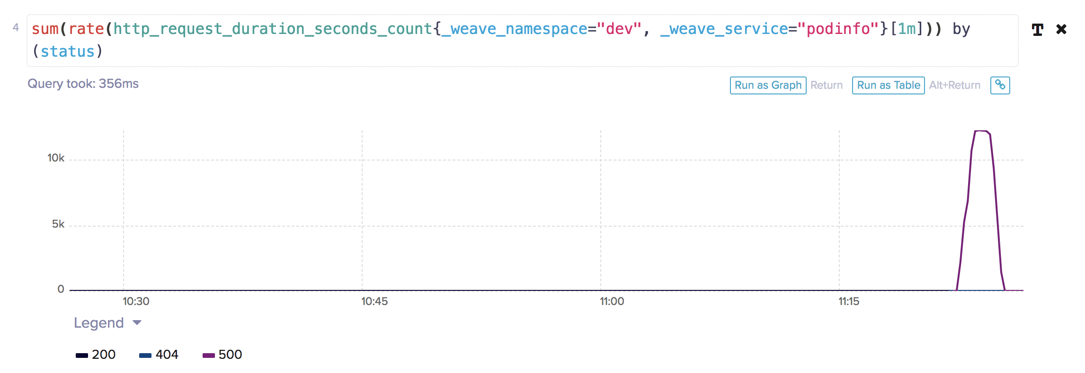
💻
Generate some test traffic

Slide 33
Putting it all together
💻
Query fraction of sucessful requests
Write an expression that shows the relative rate of requests that are responded to with a 200 status code.
This will be a gauge between 0.0 and 1.0.
(Sum of the rates of requests that are 200) / (Sum of the rates of all request)

Slide 34
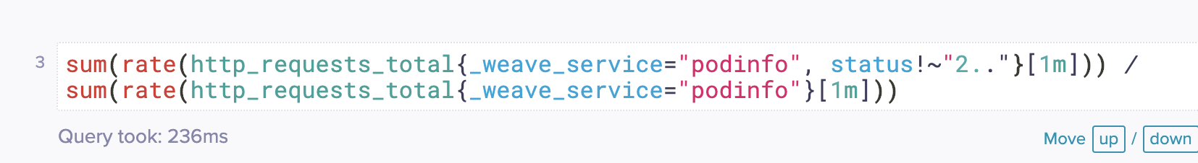
Checkpoint:
Fractional error rate graph

Slide 35
Recap: Metrics
In this session we have
Defined metrics using PromQL
Looked at using selectors to query the metrics
Use aggregate functions over multiple metrics
Create metrics that are relative to the traffic

Slide 36
Alerting with Prometheus

Slide 37
💻
From metrics to alerts
We want to be told if the number of requests to podinfo with a 500 status becomes too high. We now have a query for this. Let's use it to make an alert.
Go to the "Settings" page of your Weave Cloud instance
Select "Alerting Rules"
Expand the placeholder rules file
Enter the rule on the following slide
Hit "Save"

Slide 38
💻
Our first alert
Enter this alert into your alerting rules:
ALERT PodInfoHighErrorRate IF sum(rate(http_request_duration_seconds_count{ _weave_service="podinfo", status=~"5.."}[1m])) > 10 FOR 1m
And hit "Save".
This defines an alert that will fire when dev/podinfo is returning more than 10 responses per second with a 5XX status code for over a minute (1m).
Notes:
4 critical components:
name: here, "PodInfoHighErrorRate"
query: here, the same query as before
threshold: here, 10
duration: here, 1m
"5.." is a regular expression.
Note: https://github.com/weaveworks/service-ui/issues/2477 (a copy/paste glitch) will probably hit some people here, if they're using copy/paste

Slide 39
Triggering the Alert
💻
Trigger the alert
To check that the alert works, switch back to your console and generate some traffic on the error endpoint:
➤ kubectl run hey --image=ricoli/hey --it --rm --restart=Never --command -- hey -z 2m http://podinfo.dev:9898/status/500
Switch back to Weave Cloud so you can see the in-browser alert when it pops up.
Notes:
If they miss the in-browser alert, they can check the notifications history by clicking the bell icon in the navbar.

Slide 40
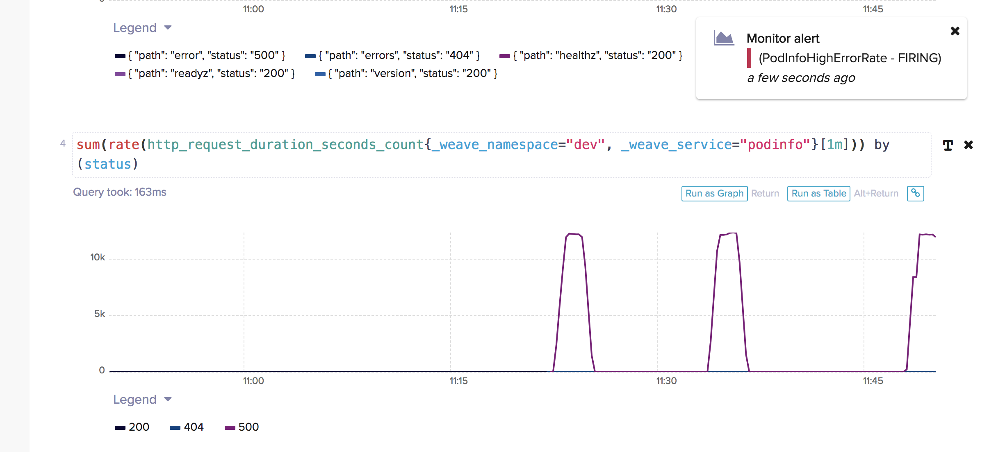
A firing alert
Notes:
A few minutes after the errors subside, another notification will pop up saying the error is resolved. jml doesn't recommend waiting around for this.

Slide 41
Practical Alerts
Our current alert is not very practical.
The threshold is an absolute number of errors per second (10), but we expect errors to scale with overall traffic
The alert provides us with very little information if we want to debug the problem
Alerting after only one minute is pretty tight—we would get too many false positives
Notes:
Everything after this is gravy. Depending on timings, you can leave these as "take-home" exercises or you can go through the next slides, which will address points 1 & 2 but not 3.

Slide 42
Scaling Alerts with Traffic
💻
Scale the alert to the traffic
Rather than alerting on an absolute number of errors per second, we want to alert on what fraction of requests are erroring. Edit the alert so it matches the following:
ALERT PodInfoHighErrorRate IF sum(rate(http_request_duration_seconds_count{ _weave_service="podinfo", status=~"5.."}[1m])) / sum(rate(http_request_duration_seconds_count{ _weave_service="podinfo"}[1m])) > 0.1 FOR 1m
This will now fire when 10% (0.1) of requests are returning 5XX responses.
Notes:
Alerting on %age also ties much better to SLAs.
Bold bits are the new / modified bits

Slide 43
Adding More Information (for computers)
We can add more information to the alert to make it easier to respond to. Labels are extra Prometheus labels that are added to the alert, and are good for structured data.
For example, you could update your alert to say that the PodInfoHighErrorRate alert is of critical severity:
ALERT PodInfoHighErrorRate IF sum(rate(…)) > 0.1 FOR 1m LABELS { severity="critical" }
Notes:
Not sure if we want to mention alert routing here?

Slide 44
Adding More Information (for humans)
We can add more information to the alert to make it easier to respond to. Annotations are extra information for the alert, and are good for things like descriptions or playbook links:
ALERT PodInfoHighErrorRate IF sum(rate(…)) > 0.1 FOR 1m LABELS { severity="critical" } ANNOTATIONS { impact = "Workshop attendees cannot get pod info", playbookURL ="https://example.com/playbooks/PodInfoHighErrorRate", }
Notes:
Weave Cloud treat impact & playbookURL specially

Slide 45
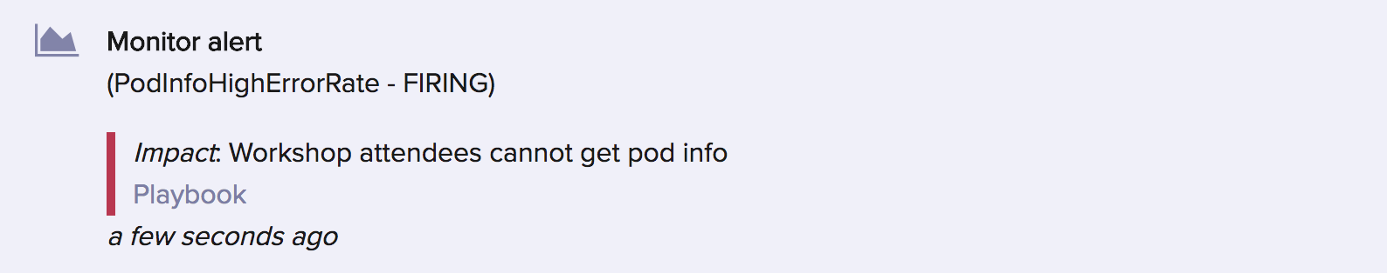
Richer information
Notes:
Weave Cloud treats "impact" and "playbookURL" specially. Our accelerator pack takes full advantage of this. Check it out!

Slide 46
Receiving Alerts
Sitting around a watching a browser for notifications isn't ideal. It's better to configure Weave Cloud to send alerts via email or Slack.
Browse to Settings > Config > Notifications
Scroll down to Integrations and click "Configure Email"
Enter the email address you used to sign up to this workshop
Click "Send Test Notification" to send a test email
Scroll back up and check the "Monitor alert" box in the Email column
Once you've done all this, you can run the load generator again to trigger an alert, and then check your inbox to see the message.

Slide 47
Writing great alerts
There is a difference between Notifications and Pages although both might use Prometheus’ alerting mechanism.
Pages will wake someone in the middle of the night.
Pages should occur when you have broken your SLO. When you are failing to meet expectations.
Notifications won’t wake someone up, but are likely very useful from an operation point of view.
You can learn more about this in the SRE Book (https://landing.google.com/sre/books/)

Slide 48
Recap: Alerts
In this session we have
Explored our metrics to find what condition we wanted to alert on
Used those queries to define an alert
Provided useful contextual information to help us debug that alert when it happens
Configured Weave Cloud to send us alerts via email

